Slide 1
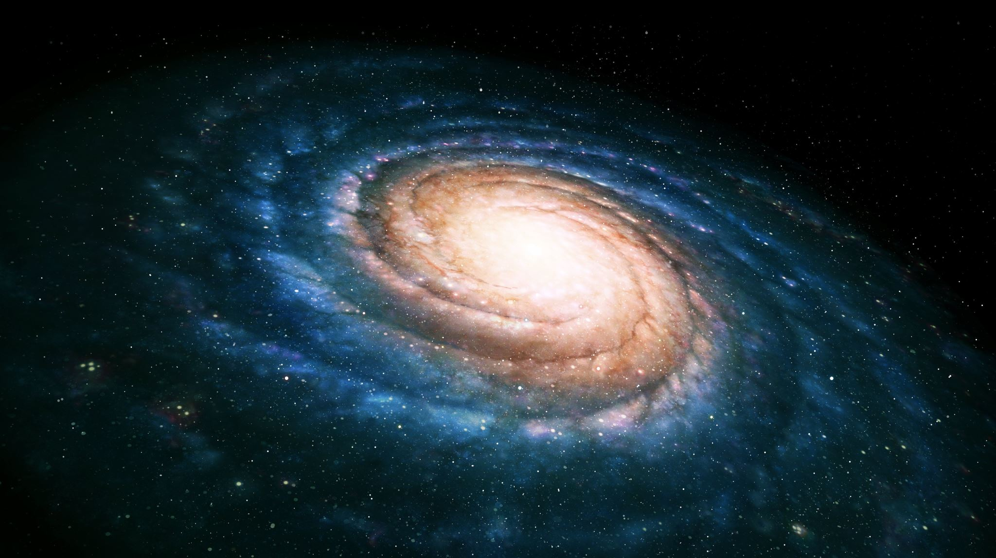
Ambidextrous Universe
By Martin Gardner

Slide 2

Keywords
Center of Symmetry
Axis of symmetry
Plane of symmetry
Lineland
Flatland
Solid land

Slide 3

Animals, insects or bird in mirror
Parakeet –(cannot) jumps back and front
Ape – (can) recognizes the mirror image is it’s own
Pigeon – (can) peck at a spot of dye.
Lewis Carroll’ Alice – everything in the room seems to “go the other way”.
Everything??
Clocks
Hold a book up to a mirror
No

Slide 4
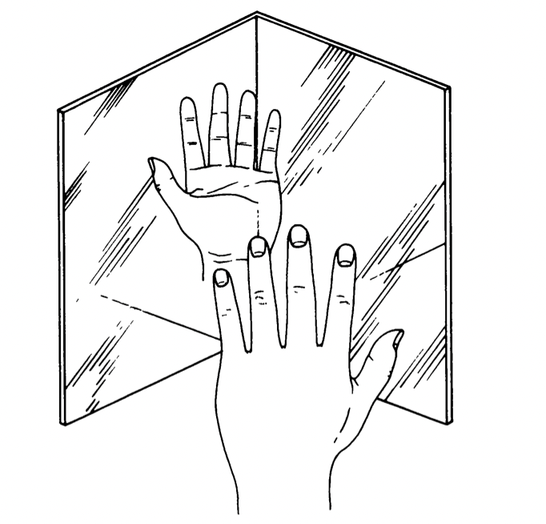
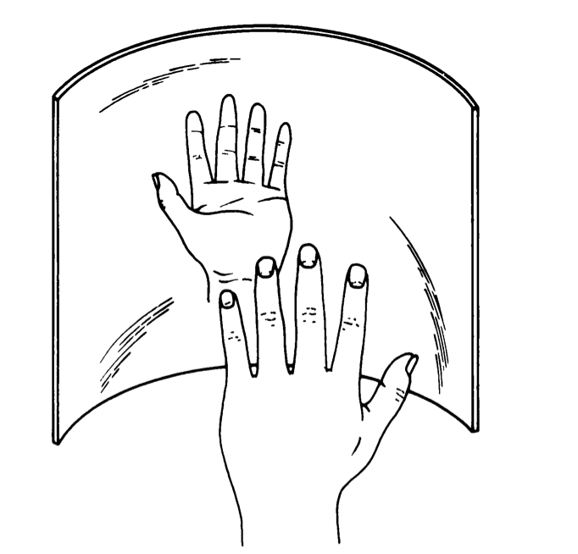
Is there any Setting which does not reverse images?
Two mirrors placed at right angles to each other
Curved mirror

Slide 5
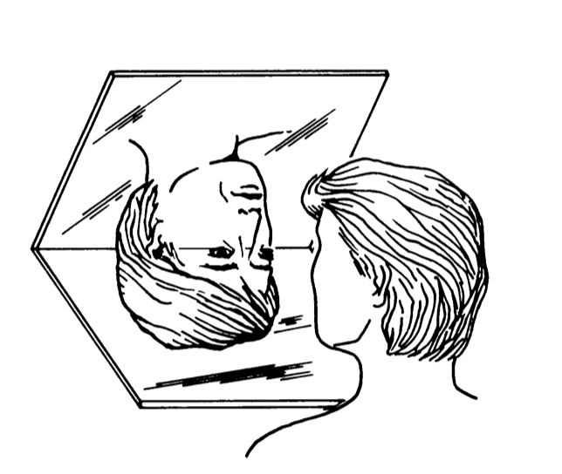
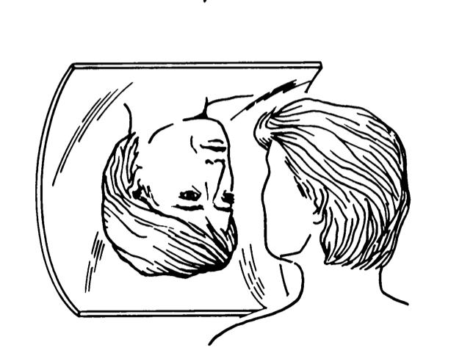
Can we reverse the image upside down with these mirrors?
Rotate mirrors by 90°
Two mirrors placed at right angles to each other
Rotated 90 °
Curved mirror – Rotated 90 °

Slide 6
Two scientific events
Discovery of corkscrew structure of molecule that carries genetic code - biologists
Overthrow of parity - physicists
Connected with left and right and the nature of mirror reversals.

Slide 7
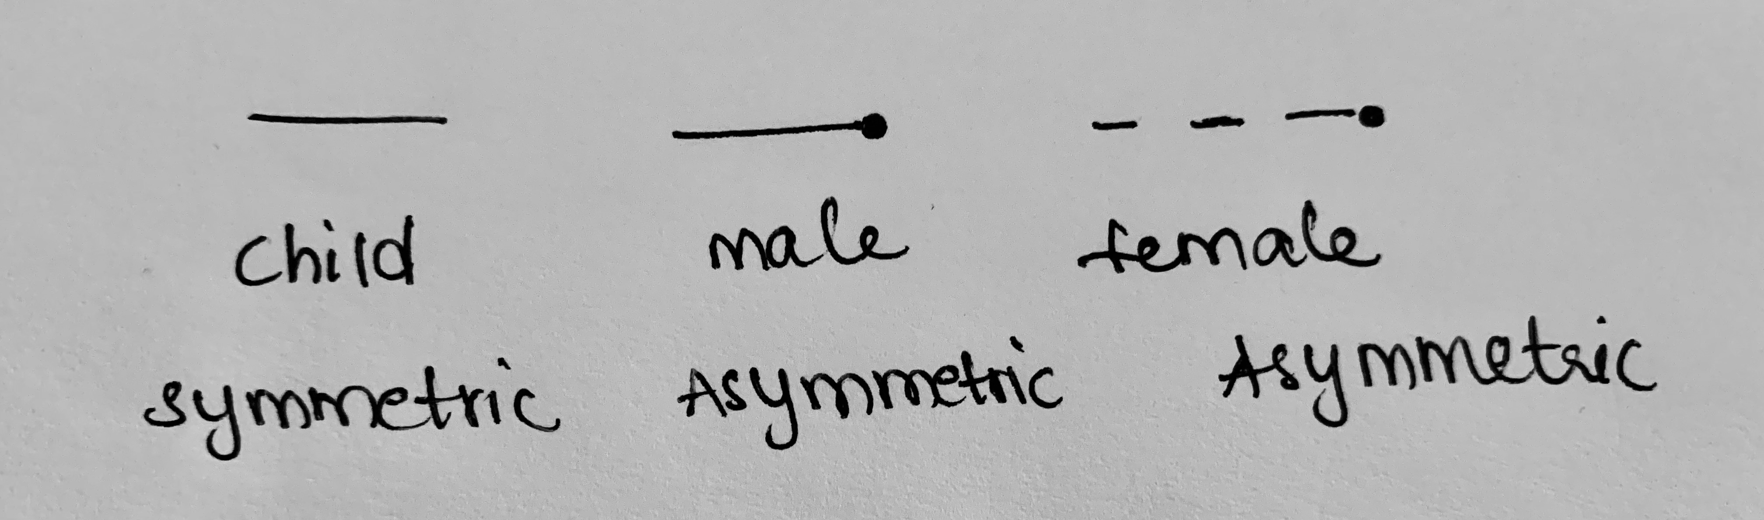
Center of Symmetry
LineLand – 1 D space – consists of all points along single line.
1D objects - Linelanders
Example on how reversal in 1D effects objects
*turning over might make objects coincide, but requires 1D higher than the original space

Slide 8


Axis of Symmetry
Flatland – 2D space
2D objects – Flatlanders
What is the maximum number of possible axis of symmetry?
2
1 to infinity
Solidland – 3D space
Plane of Symmetry
Enantiomorphs – hand, gloves, ears, shoes, scissors
Example on Topology:
Fold your hands
Why are screws and bolts have right- handed threads?

Slide 9
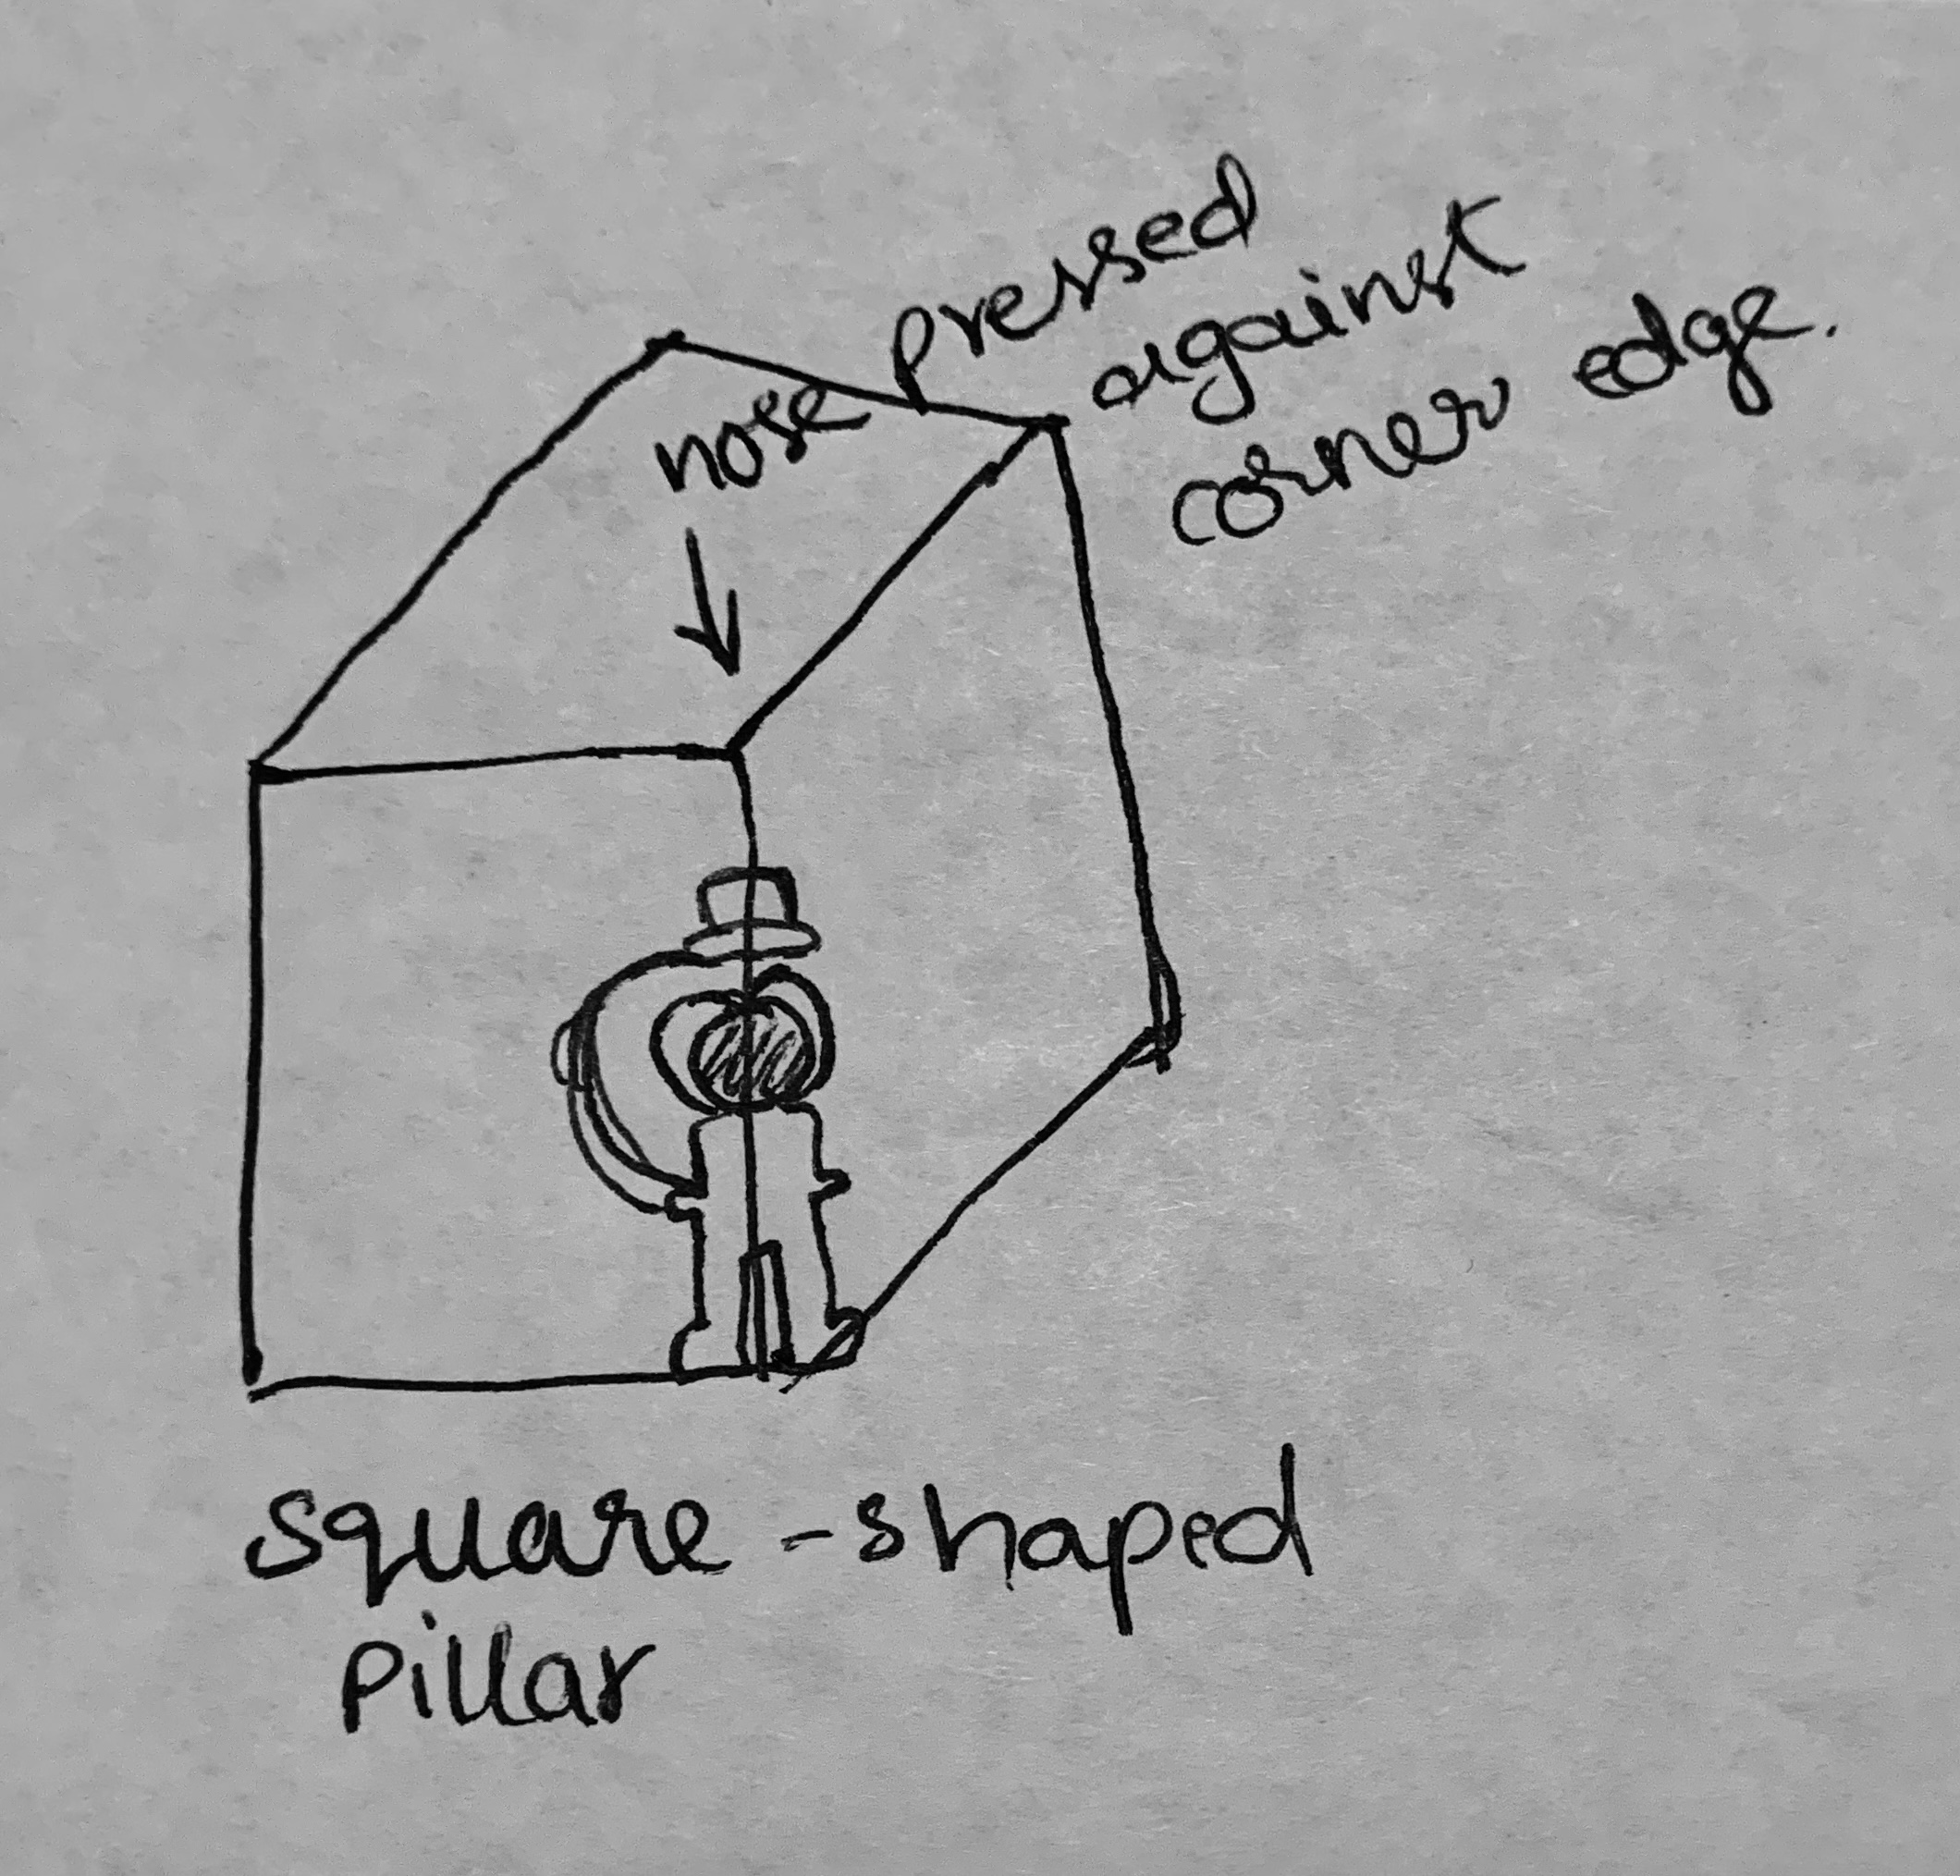
Our bodies have only one plane of symmetry.
Bilateral symmetry – left side is a mirror reflection of the right.
Gravity pulls all things downward – thousands of objects (chairs, tables, rooms, buildings, trains, airplanes) have bilateral symmetry.
Reversal is a left- right one – most convenient terminology.
Magic with words:
COOKBOOK
ELECTRONIC
AUTOMATA
TIMOTHY
REBECCA
CHOICE QUALITY

Slide 10
Body relative directions are called Egocentric coordinates
Up and down – uses gravity and planet earth as a frame of reference.
UP – direction in which object is allowed to fall freely.
DOWN – opposite to earth.
Given a significant distance from magnetic poles,
We can use magnetic compass and sun to figure out left and right.
Facing the sun, before noon, the north pointer of compass points to the left hand.
Afternoon, it points to the right hand.

Slide 11
TOTAL HORSES : 125
TRACKS : 5
NO. OF RACES : 25
Top 3 horses
A | B | C | D | E | F | G | H | I | J | K | L | M | N | O | P | Q | R | S | T | U | V | W | X | Y
A1 | B1 | C1 | D1 | E1 | F1 | G1 | H1 | I1 | J1 | K1 | L1 | M1 | N1 | O1 | P1 | Q1 | R1 | S1 | T1 | U1 | V1 | W1 | X1 | Y1
A2 | B2 | C2 | D2 | E2 | F2 | G2 | H2 | I2 | J2 | K2 | L2 | M2 | N2 | O2 | P2 | Q2 | R2 | S2 | T2 | U2 | V2 | W2 | X2 | Y2
A3 | B3 | C3 | D3 | E3 | F3 | G3 | H3 | I3 | J3 | K3 | L3 | M3 | N3 | O3 | P3 | Q3 | R3 | S3 | T3 | U3 | V3 | W3 | X3 | Y3
A4 | B4 | C4 | D4 | E4 | F4 | G4 | H4 | I4 | J4 | K4 | L4 | M4 | N4 | O4 | P4 | Q4 | R4 | S4 | T4 | U4 | V4 | W4 | X4 | Y4
A5 | B5 | C5 | D5 | E5 | F5 | G5 | H5 | I5 | J5 | K5 | L5 | M5 | N5 | O5 | P5 | Q5 | R5 | S5 | T5 | U5 | V5 | W5 | X5 | Y5
[A-Y] –sets of 5 horses
i ∊ [A-Y]
i1, i2, i3, i4, i5 are 1st 2nd 3rd 4th and 5th positioned horses respectively

Slide 12
TOTAL HORSES : 125
TRACKS : 5
NO. OF RACES : 25
A | B | C | D | E | F | G | H | I | J | K | L | M | N | O | P | Q | R | S | T | U | V | W | X | Y
A1 | B1 | C1 | D1 | E1 | F1 | G1 | H1 | I1 | J1 | K1 | L1 | M1 | N1 | O1 | P1 | Q1 | R1 | S1 | T1 | U1 | V1 | W1 | X1 | Y1
A2 | B2 | C2 | D2 | E2 | F2 | G2 | H2 | I2 | J2 | K2 | L2 | M2 | N2 | O2 | P2 | Q2 | R2 | S2 | T2 | U2 | V2 | W2 | X2 | Y2
A3 | B3 | C3 | D3 | E3 | F3 | G3 | H3 | I3 | J3 | K3 | L3 | M3 | N3 | O3 | P3 | Q3 | R3 | S3 | T3 | U3 | V3 | W3 | X3 | Y3
A4 | B4 | C4 | D4 | E4 | F4 | G4 | H4 | I4 | J4 | K4 | L4 | M4 | N4 | O4 | P4 | Q4 | R4 | S4 | T4 | U4 | V4 | W4 | X4 | Y4
A5 | B5 | C5 | D5 | E5 | F5 | G5 | H5 | I5 | J5 | K5 | L5 | M5 | N5 | O5 | P5 | Q5 | R5 | S5 | T5 | U5 | V5 | W5 | X5 | Y5
Eliminate 4th and 5th positioned horses in every race

Slide 13

TOTAL HORSES : 125
TRACKS : 5
NO. OF RACES : 26
A | B | C | D | E | F | G | H | I | J | K | L | M | N | O | P | Q | R | S | T | U | V | W | X | Y
A1 | B1 | C1 | D1 | E1 | F1 | G1 | H1 | I1 | J1 | K1 | L1 | M1 | N1 | O1 | P1 | Q1 | R1 | S1 | T1 | U1 | V1 | W1 | X1 | Y1
A2 | B2 | C2 | D2 | E2 | F2 | G2 | H2 | I2 | J2 | K2 | L2 | M2 | N2 | O2 | P2 | Q2 | R2 | S2 | T2 | U2 | V2 | W2 | X2 | Y2
A3 | B3 | C3 | D3 | E3 | F3 | G3 | H3 | I3 | J3 | K3 | L3 | M3 | N3 | O3 | P3 | Q3 | R3 | S3 | T3 | U3 | V3 | W3 | X3 | Y3
Conduct race between A1, B1, C1, D1, E1

Slide 14
TOTAL HORSES : 125. TRACKS : 5
A | B | C | D | E | F | G | H | I | J | K | L | M | N | O | P | Q | R | S | T | U | V | W | X | Y
A1 | B1 | C1 | D1 | E1 | F1 | G1 | H1 | I1 | J1 | K1 | L1 | M1 | N1 | O1 | P1 | Q1 | R1 | S1 | T1 | U1 | V1 | W1 | X1 | Y1
A2 | B2 | C2 | D2 | E2 | F2 | G2 | H2 | I2 | J2 | K2 | L2 | M2 | N2 | O2 | P2 | Q2 | R2 | S2 | T2 | U2 | V2 | W2 | X2 | Y2
A3 | B3 | C3 | D3 | E3 | F3 | G3 | H3 | I3 | J3 | K3 | L3 | M3 | N3 | O3 | P3 | Q3 | R3 | S3 | T3 | U3 | V3 | W3 | X3 | Y3
1ST | 2ND | 3RD
A1 | A2 | A3
A1 | A2 | B1
A1 | B1 | C1
A1 | B1 | B2
A1 | F1 | K1
A1 | F1 | F2
A1 | F1 | F2
A1 | A2 | F1
A1 | B1 | F1
A1 | F1 | G1
race | eliminate
A1,B1, C1, D1 E1 | D, E
F1, G1, H1, I1,J1 | I, J
K1,L1, M1, N1, O1 | N,O
P1,Q1,R1,S1,T1 | S,T
U1,V1,W1,X1,Y1 | X,Y
A1,F1,K1,P1,U1 | P,Q,R, U,V,W
A1 - WINNER

Slide 15
TOTAL HORSES : 125
TRACKS : 5
NO. OF RACES : 27
A | B | C | F | G | H | I | J | K | L | M | N | O | P | Q | R | S | T | U | V | W | X | Y
A1 | B1 | C1 | F1 | G1 | H1 | I1 | J1 | K1 | L1 | M1 | N1 | O1 | P1 | Q1 | R1 | S1 | T1 | U1 | V1 | W1 | X1 | Y1
A2 | B2 | C2 | F2 | G2 | H2 | I2 | J2 | K2 | L2 | M2 | N2 | O2 | P2 | Q2 | R2 | S2 | T2 | U2 | V2 | W2 | X2 | Y2
A3 | B3 | C3 | F3 | G3 | H3 | I3 | J3 | K3 | L3 | M3 | N3 | O3 | P3 | Q3 | R3 | S3 | T3 | U3 | V3 | W3 | X3 | Y3
Conduct race between A1, B1, C1, F1, G1

Slide 16
TOTAL HORSES : 125
TRACKS : 5
NO. OF RACES : 28
A | B | C | H | I | J | K | L | M | N | O | P | Q | R | S | T | U | V | W | X | Y
A1 | B1 | C1 | H1 | I1 | J1 | K1 | L1 | M1 | N1 | O1 | P1 | Q1 | R1 | S1 | T1 | U1 | V1 | W1 | X1 | Y1
A2 | B2 | C2 | H2 | I2 | J2 | K2 | L2 | M2 | N2 | O2 | P2 | Q2 | R2 | S2 | T2 | U2 | V2 | W2 | X2 | Y2
A3 | B3 | C3 | H3 | I3 | J3 | K3 | L3 | M3 | N3 | O3 | P3 | Q3 | R3 | S3 | T3 | U3 | V3 | W3 | X3 | Y3
Conduct race between A1, B1, C1, H1, I1

Slide 17
TOTAL HORSES : 125
TRACKS : 5
NO. OF RACES : 29
A | B | C | J | K | L | M | N | O | P | Q | R | S | T | U | V | W | X | Y
A1 | B1 | C1 | J1 | K1 | L1 | M1 | N1 | O1 | P1 | Q1 | R1 | S1 | T1 | U1 | V1 | W1 | X1 | Y1
A2 | B2 | C2 | J2 | K2 | L2 | M2 | N2 | O2 | P2 | Q2 | R2 | S2 | T2 | U2 | V2 | W2 | X2 | Y2
A3 | B3 | C3 | J3 | K3 | L3 | M3 | N3 | O3 | P3 | Q3 | R3 | S3 | T3 | U3 | V3 | W3 | X3 | Y3
Conduct race between A1, B1, C1, J1, K1

Slide 18
TOTAL HORSES : 125
TRACKS : 5
NO. OF RACES : 30
A | B | C | L | M | N | O | P | Q | R | S | T | U | V | W | X | Y
A1 | B1 | C1 | L1 | M1 | N1 | O1 | P1 | Q1 | R1 | S1 | T1 | U1 | V1 | W1 | X1 | Y1
A2 | B2 | C2 | L2 | M2 | N2 | O2 | P2 | Q2 | R2 | S2 | T2 | U2 | V2 | W2 | X2 | Y2
A3 | B3 | C3 | L3 | M3 | N3 | O3 | P3 | Q3 | R3 | S3 | T3 | U3 | V3 | W3 | X3 | Y3
Conduct race between A1, B1, C1, L1, M1

Slide 19
TOTAL HORSES : 125
TRACKS : 5
NO. OF RACES : 31
A | B | C | N | O | P | Q | R | S | T | U | V | W | X | Y
A1 | B1 | C1 | N1 | O1 | P1 | Q1 | R1 | S1 | T1 | U1 | V1 | W1 | X1 | Y1
A2 | B2 | C2 | N2 | O2 | P2 | Q2 | R2 | S2 | T2 | U2 | V2 | W2 | X2 | Y2
A3 | B3 | C3 | N3 | O3 | P3 | Q3 | R3 | S3 | T3 | U3 | V3 | W3 | X3 | Y3
Conduct race between A1, B1, C1, N1, O1

Slide 20
TOTAL HORSES : 125
TRACKS : 5
NO. OF RACES : 32
A | B | C | P | Q | R | S | T | U | V | W | X | Y
A1 | B1 | C1 | P1 | Q1 | R1 | S1 | T1 | U1 | V1 | W1 | X1 | Y1
A2 | B2 | C2 | P2 | Q2 | R2 | S2 | T2 | U2 | V2 | W2 | X2 | Y2
A3 | B3 | C3 | P3 | Q3 | R3 | S3 | T3 | U3 | V3 | W3 | X3 | Y3
Conduct race between A1, B1, C1, P1, Q1

Slide 21
TOTAL HORSES : 125
TRACKS : 5
NO. OF RACES : 33
A | B | C | R | S | T | U | V | W | X | Y
A1 | B1 | C1 | R1 | S1 | T1 | U1 | V1 | W1 | X1 | Y1
A2 | B2 | C2 | R2 | S2 | T2 | U2 | V2 | W2 | X2 | Y2
A3 | B3 | C3 | R3 | S3 | T3 | U3 | V3 | W3 | X3 | Y3
Conduct race between A1, B1, C1, R1, S1

Slide 22
TOTAL HORSES : 125
TRACKS : 5
NO. OF RACES : 34
A | B | C | T | U | V | W | X | Y
A1 | B1 | C1 | T1 | U1 | V1 | W1 | X1 | Y1
A2 | B2 | C2 | T2 | U2 | V2 | W2 | X2 | Y2
A3 | B3 | C3 | T3 | U3 | V3 | W3 | X3 | Y3
Conduct race between A1, B1, C1, T1, U1

Slide 23
TOTAL HORSES : 125
TRACKS : 5
NO. OF RACES : 35
A | B | C | V | W | X | Y
A1 | B1 | C1 | V1 | W1 | X1 | Y1
A2 | B2 | C2 | V2 | W2 | X2 | Y2
A3 | B3 | C3 | V3 | W3 | X3 | Y3
Conduct race between A1, B1, C1, V1, W1

Slide 24
TOTAL HORSES : 125
TRACKS : 5
NO. OF RACES : 36
A | B | C | X | Y
A1 | B1 | C1 | X1 | Y1
A2 | B2 | C2 | X2 | Y2
A3 | B3 | C3 | X3 | Y3
Conduct race between A1, B1, C1, X1, Y1

Slide 25
TOTAL HORSES : 125
TRACKS : 5
NO. OF RACES : 36
A | B | C
A1 | B1 | C1
A2 | B2 | C2
A3 | B3 | C3
A | B | C
A1 | B1 | C1
A2 | B2 | C2
A3 | B3 | C3
A1 is the 1st winner among all the horses.

Slide 26
TOTAL HORSES : 125
TRACKS : 5
NO. OF RACES : 37
A | B | C
A1 | B1 | C1
A2 | B2
A3
A1 is the 1st winner among all the horses.
Now conduct race among A2, A3, B1, B2, C1
Pick top 2 winners and name them H1, H2
Total minimum number of races : 37
Top 3 horses are A1, H1, H2
Min number of races : 25 + 11 + 1

Slide 27
Living Molecules
Virus – Living thing – tiniest of all.
Simple virus – mosaic disease on tobacco plants.
Virus crystallizes into tiny rods (right – handed helical structure.)
Formed by 200 identical molecules – 150 amino acids subunits(nucleotides).
Nucleic acid – DNA and RNA
Every virus – shell of protein, enclosing one or more coils of nucleic acid.
Doubt – The nucleic acid, not the protein, kills the host.
Four different nucleotide bases (A, T, G, C) along each coil is the genetic code that tells the cell what to do.
Example : PIRATE, IRATE, RATE

Slide 28
No doubt on four- symbol code carrying the information to provide complete blueprint.
Genetic code – ability to control and direct the course of evolution.
Full understanding of code – generation of new life.
RNA molecule, not it’s protein shell, that has the power of self- replication and mutation.
Living Vs. Non living.
Example : Machine, worker bees – cannot copy themselves.
Virus blue- green object either green or blue – a living dead thing.
Ability of an organism to take compound from its immediate environment - plants.

Slide 29
The origin of Life
Life on earth might have risen from deep – frozen spores that had been propelled here through interstellar space by the pressure of radiation from the stars.
Microscopic particles in meteorites – fossils of plant life.
Meteorites – fossil evidence of once - living things.
Found variety of amino acids in fragment of this meteorite.
Life on earth may have risen from microbes in the garbage left.
Biggest leap was from beast to human.
Microbes were spontaneously generated in stagnant water.
Amino acids are generated in a week – mixture of ammonia, methane and hydrogen.

Slide 30
Synthesize 13 different amino acids by using heat.
Synthesized ribonuclease, an enzyme made of 19 types of amino acids.
Hydrogen and Oxygen combined at random.
HHH, HHO, HOH, HOO
All molecules would be water.
Random production of asymmetric amino acids – 1 week

Slide 31
The origin of Asymmetry
Each molecule could only feed on molecule of its own handedness.
If mutation of one-left handed molecule gave it the ability to feed on both handed compounds

Slide 32
The Fourth Dimension
Enantiomorphic polyhedrons – look similar- not identical.
Room in mirror – It is the same room, yet it isn’t.
Asymmetric solid object could be reversed by rotating it through a higher space.
Incongruent counterparts – Asymmetric solid figures of identical size and shape but opposite handedness
Example – Left and right hands.
Given a single human hand. Is it Left or right?
We have no basis for calling the hand left or right.

Slide 33
Given a hand and human body severed at the wrist and are missing.
Hand will not fit both hands.
In a flatland, it is not possible to define a hand as left or right until there is another asymmetric structure on the plane.
Flatlanders define left as the side on which heart is located.
Initial choice of terms is wholly arbitrary.

Slide 34
TOTAL HORSES : 125. TRACKS : 5
A | B | C | D | E | F | G | H | I | J | K | L | M | N | O | P | Q | R | S | T | U | V | W | X | Y
A1 | B1 | C1 | D1 | E1 | F1 | G1 | H1 | I1 | J1 | K1 | L1 | M1 | N1 | O1 | P1 | Q1 | R1 | S1 | T1 | U1 | V1 | W1 | X1 | Y1
A2 | B2 | C2 | D2 | E2 | F2 | G2 | H2 | I2 | J2 | K2 | L2 | M2 | N2 | O2 | P2 | Q2 | R2 | S2 | T2 | U2 | V2 | W2 | X2 | Y2
A3 | B3 | C3 | D3 | E3 | F3 | G3 | H3 | I3 | J3 | K3 | L3 | M3 | N3 | O3 | P3 | Q3 | R3 | S3 | T3 | U3 | V3 | W3 | X3 | Y3
1ST | 2ND | 3RD
A1 | A2 | A3
A1 | A2 | B1
A1 | B1 | C1
A1 | B1 | B2
A1 | F1 | K1
A1 | F1 | F2
A1 | F1 | F2
A1 | A2 | F1
A1 | B1 | F1
A1 | F1 | G1
race | eliminate
A1,B1, C1, D1 E1 | D, E
F1, G1, H1, I1,J1 | I, J
K1,L1, M1, N1, O1 | N,O
P1,Q1,R1,S1,T1 | S,T
U1,V1,W1,X1,Y1 | X,Y
A1,F1,K1,P1,U1 | P,Q,R, U,V,W
A1 - WINNER

Slide 35
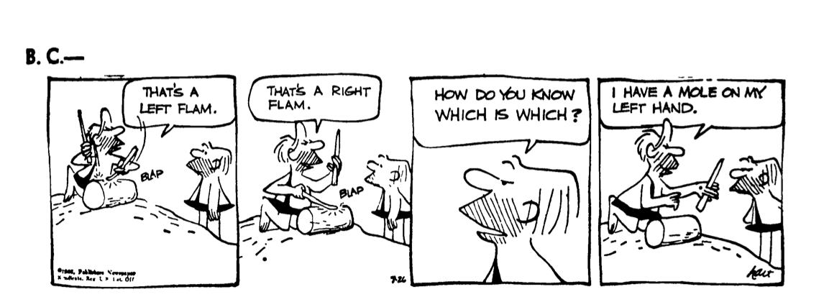

Slide 36
Is the ball large or small?
Cannot say until there is some other ball to compare in space.
2D space – square
3D space – Cube
4D space –hypercube.
And so on.
Two shapes are superposable,
Picking one up, turning it over, fitting it, point for point, on the other

Slide 37
4Dspace - Kitchen corkscrew, can see right-handed helix from one position.
Changes his position – Left-handed helix.
When a corkscrew is picked up, turned over, replace it – corkscrew vanishes, reappear in reflected form.
Enantiomorphic objects are identical not only in all metric properties – topologically identical
In every space of n dimensions an asymmetric figure can be made to coincide with its reflection by rotating it through a space of n+1 dimensions
Two strips- placed one over the other, make half twist and join the ends
Two swastikas placed on a strip.

Slide 38
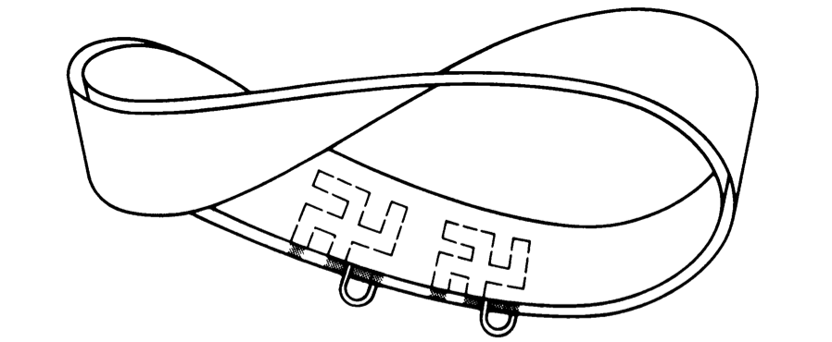

Slide 39
Parity
Parity – distinguish between odd and even numbers.
Applied in any situation where things fall neatly into two mutually exclusive cases.

Slide 40
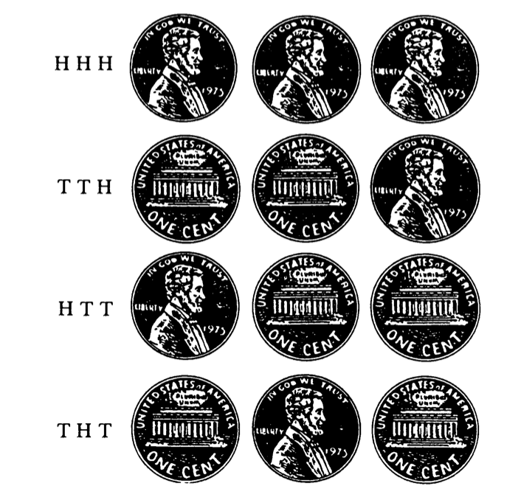
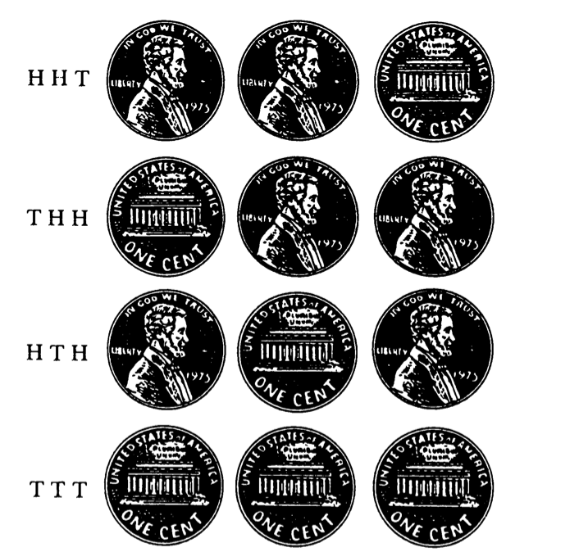

Slide 41
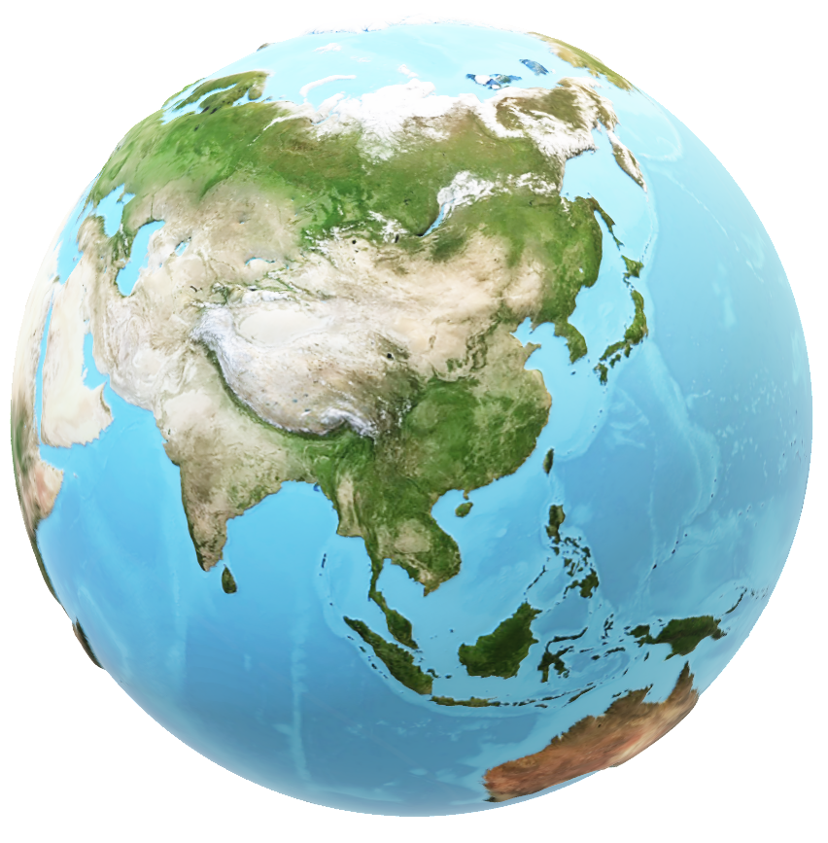
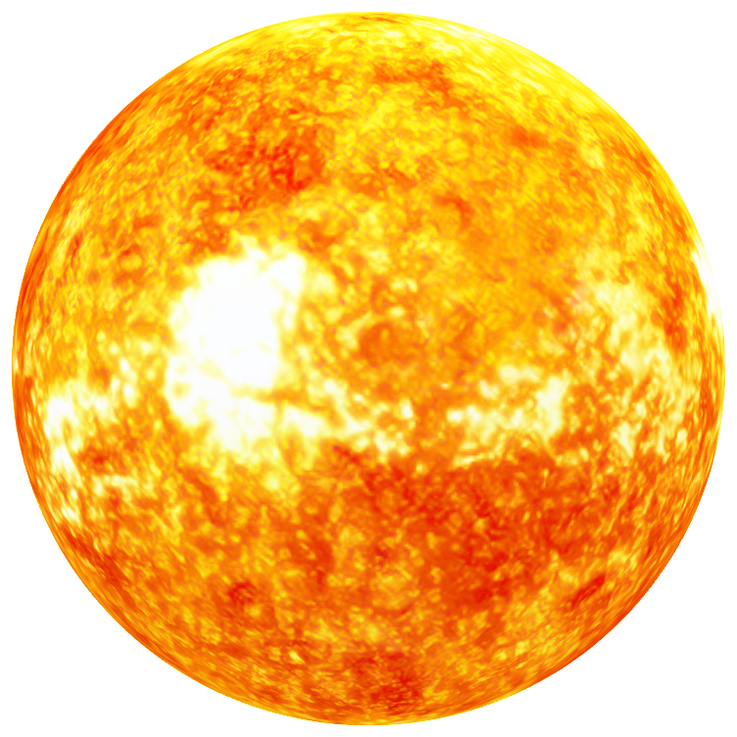
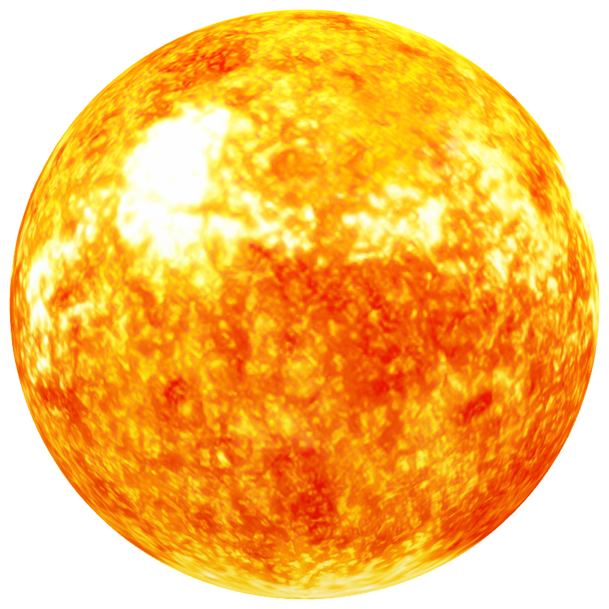
The Ozma Problem

Slide 42


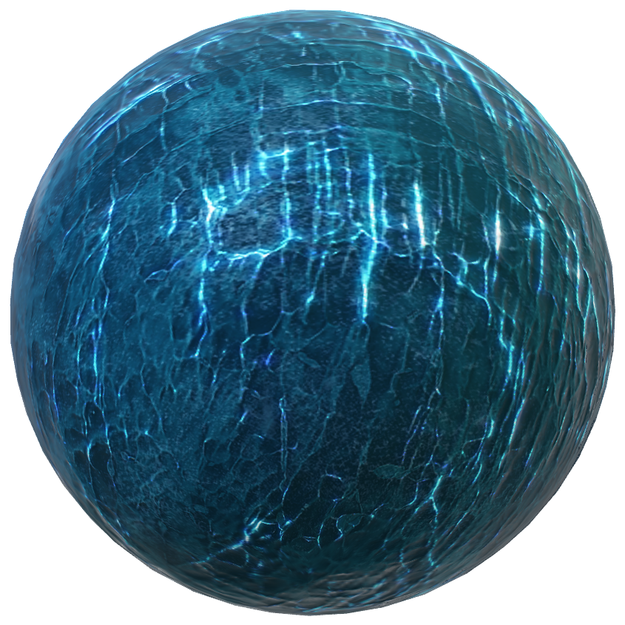
Astronomers thought planets were extremely rare in the universe.
Astronomers now believe that planets are extremely common in the universe
Unknown
Planet X
Planet earth

Slide 43
Transmit this image using binary.
Scanning the rectangle from top- bottom, left - right
Top – direction away from the center of the planet
Bottom – Towards the planet’s center
Left – right??
Picture of right-handed helix. What if they are scanning the other way??
Condition: There is to be no asymmetric object or structure that we and they can observe in common

Slide 44
Possibilities:
A picture of man labeled top, bottom, left, right ?
A radio beam that had given a helical twist by circular polarization, planet X build antennas to determine polarization was clockwise or counterclockwise?
Ask them to point a telescope towards a certain asymmetric configuration of stars and to use this stellar pattern for defining left, and right?
Violates the above condition
Is it possible to transit instructions for drawing a geometrical design or graph of some sort that would explain to them what we mean by left?
Nazi swastika – left and right forms.
Could we explain to planet X how to identify a crystal such as quartz that twisted polarized light a certain way?
How about asymmetry of carbon compounds in living tissues?
Amino acids - left-handed, helices of protein and nucleic acid are right-handed.

Slide 45
Earth is rotating on an axis. Is there any way this rotation could be used as a basis of defining left?
Northern hemisphere – Foucault pendulum – clockwise,
Southern hemisphere – Foucault pendulum – anti clockwise
Planet X’s north and south poles?
Planet X has a magnetic field with north and south poles that correspond closely to the poles of the planet’s axis of rotation. Would that be of any help?
Magnetic poles do a peculiar flip – flop.
No way of communicating the necessary information without having a common understanding of left and right.

Slide 46
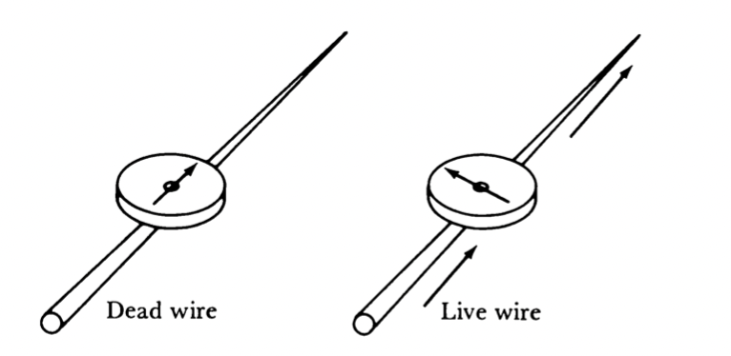
Mach’s shock
Left – direction the compass needle points when the current beneath it is moving away from us.
But planet X’s north and south pole?

Slide 47
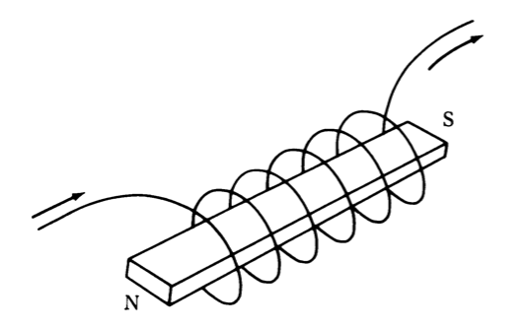
A magnet’s north pole is the pole attracted by earth’s north magnetic pole.
Confusing??
Earth’s north magnetic pole is its “south pole”.
South magnetic pole is near to geographic north pole.
Earth’s south magnetic pole is its “north pole”.
Left and right handed helix

Slide 48
Parity
Parity – distinguish between odd and even numbers.
Applied in any situation where things fall neatly into two mutually exclusive cases.

Slide 50
The Fall of Parity
Forces and strength
Nuclear force
Electromagnetism
Weak force
Gravity
Strength decreases
Nuclear force – proton and neutron
Electromagnetism - electrons and nucleus
Gravity * – force with which one mass attracts other mass
*Extremely difficult unless the mass is enormously large.
Elementary particles – negligible gravitational force
Weak force – force involved in decay interactions
Example – beta decay

Slide 51
Weak interaction have ‘strange particle called ‘meson’.
Theta meson – decayed into 2 pi mesons.
K mesons
Tau meson – decayed into 3 pi mesons
Pi meson – odd parity
Theta meson –even parity (parity is conserved in decay of the theta meson)
Tau meson – odd parity
Physicists dilemma :
Two K mesons – indistinguishable properties but different particles.
They could assume that in one of the decay reactions parity was not conserved

Slide 52
Madam Wu’s experiment – Non conventional method of labelling the ends of a magnetic axis
The south end is the end of a cobalt 60 nucleus that is most likely to fling out an electron.
Number of electrons divided evenly into two sets, those that shot north and those that shot south, parity would be preserved.
Cool the atoms of cobalt 60 to near absolute zero.
Line up their nuclear axes with a powerful magnetic field.
Count the number of electrons flung out by the two ends of the axes.
The end that flings out most electrons is the end that we call ‘south’.
Now we can label the ends of the magnetic axis of the field used for lining up the nuclei
Label the ends of magnetic needle.
Put such a needle above a wire in which current moves away from you.
The north pole of this needle will point in the direction we call ”left”

Slide 53
TOTAL HORSES : 125. TRACKS : 5
A | B | C | D | E | F | G | H | I | J | K | L | M | N | O | P | Q | R | S | T | U | V | W | X | Y
A1 | B1 | C1 | D1 | E1 | F1 | G1 | H1 | I1 | J1 | K1 | L1 | M1 | N1 | O1 | P1 | Q1 | R1 | S1 | T1 | U1 | V1 | W1 | X1 | Y1
A2 | B2 | C2 | D2 | E2 | F2 | G2 | H2 | I2 | J2 | K2 | L2 | M2 | N2 | O2 | P2 | Q2 | R2 | S2 | T2 | U2 | V2 | W2 | X2 | Y2
A3 | B3 | C3 | D3 | E3 | F3 | G3 | H3 | I3 | J3 | K3 | L3 | M3 | N3 | O3 | P3 | Q3 | R3 | S3 | T3 | U3 | V3 | W3 | X3 | Y3
1ST | 2ND | 3RD
A1 | A2 | A3
A1 | A2 | B1
A1 | B1 | C1
A1 | B1 | B2
A1 | F1 | K1
A1 | F1 | F2
A1 | A2 | F1
A1 | B1 | F1
A1 | F1 | G1
A1 - WINNER
race | eliminate
A1,B1, C1, D1 E1 | D, E
F1, G1, H1, I1,J1 | I, J
K1,L1, M1, N1, O1 | N,O
P1,Q1,R1,S1,T1 | S,T
U1,V1,W1,X1,Y1 | X,Y
A1,F1,K1,P1,U1 | P,Q,R, U,V,W

Slide 54
